Slide 1

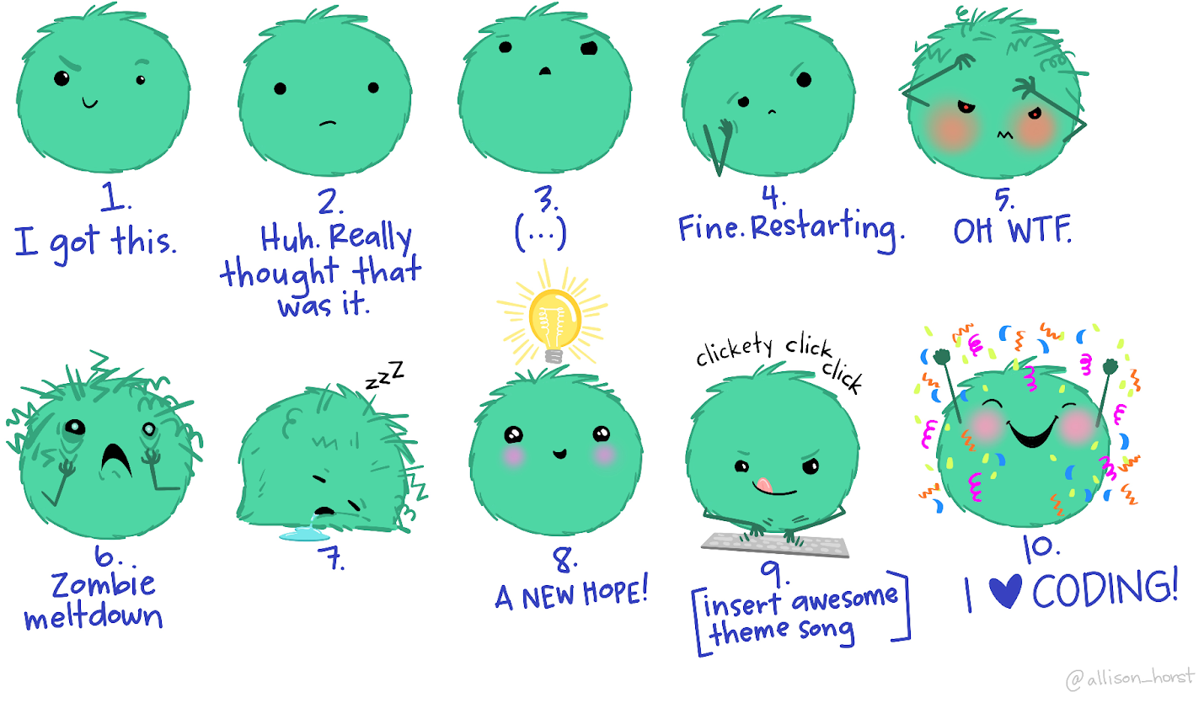
Introduction to Debugging
Artwork by @allison_horst

Slide 2

Website: www.rc.colorado.edu
Documentation: https://curc.readthedocs.io
Helpdesk: rc-help@colorado.edu
Survey: http://tinyurl.com/curc-survey18

Slide 3










Meet the User Support Team
Layla Freeborn
Brandon Reyes
Andy Monaghan
Michael Schneider
John
Reiland
Dylan Gottlieb
Mohal Khandelwal
Ragan
Lee

Slide 4
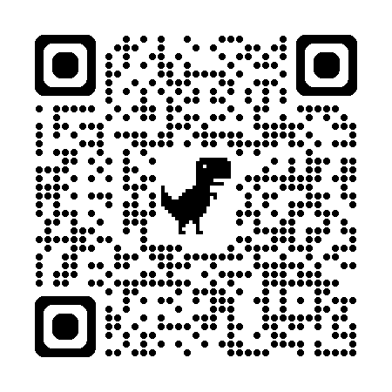
Slides https://github.com/ResearchComputing/introduction_to_debugging_shortcourse

Slide 5
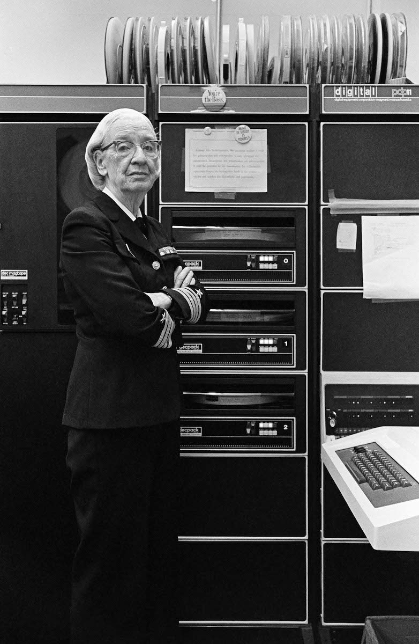
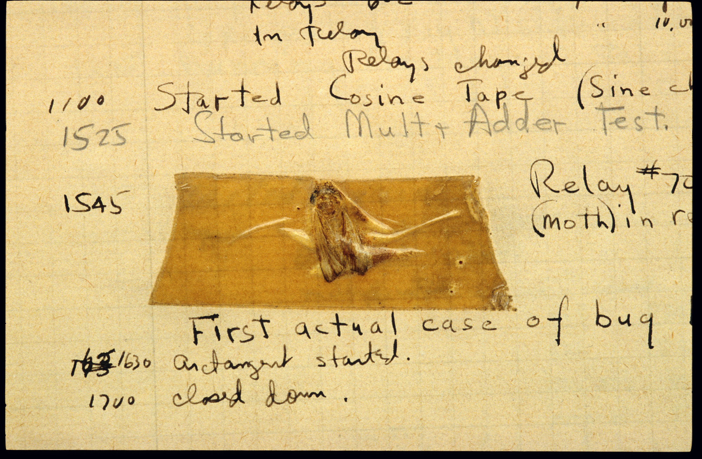
The First Programming “Bug”
5
Notes:
Bugs == Errors
The phrases (bug and debugging) are often attributed to Grace Hopper and her team – who found a literal bug (a moth) stuck in their computational machine (Mark II) – but the term is actuall an age-old engineering term dating back over century.
In this workshop, we will discuss the process of debugging and the different techniques that you can use to better find and fix the bugs.
Description (Smithsonian): ‘American engineers have been calling small flaws in machines "bugs" for over a century. Thomas Edison talked about bugs in electrical circuits in the 1870s. When the first computers were built during the early 1940s, people working on them found bugs in both the hardware of the machines and in the programs that ran them.
In 1947, engineers working on the Mark II computer at Harvard University found a moth stuck in one of the components. They taped the insect in their logbook and labeled it "first actual case of bug being found." The words "bug" and "debug" soon became a standard part of the language of computer programmers.
Among those working on the Mark II in 1947 was mathematician and computer programmer Grace Hopper, who later became a Navy rear admiral. This log book was probably not Hopper's, but she and the rest of the Mark II team helped popularize the use of the term computer bug and the related phrase "debug.”’
Image & Description Source: https://americanhistory.si.edu/collections/nmah_334663

Slide 6

Debugging Process
Observe a Bug
6
Notes:
Before we can start debugging, we must first recognize the need for debugging – i.e. observe a bug.
In the context of software programming, a bug refers to a moment when a system behaves in an unexpected or unintended manner.
This “unexpected behavior” can run the gambit of incorrect output to the full-blown system crashes!

Slide 7

Debugging Process
Observe a Bug
Find the Cause
7
Notes:
After observing a bug, we must start searching for its underlying cause – which could be any one of a variety of potential errors.
It is important to note that the error, or errors, can exist across three spaces – the project’s code, the system running the code, and then engineer’s mind.
Today we’ll be focusing on the first space, code, but it is important to always remember to check for issues in the system’s hardware and your own understanding of the system and the code.

Slide 8

Debugging Process
Observe a Bug
Find the Cause
Fix it!
8
Notes:
Once the error, or errors, has been identified it must be fixed.
This is the final, and often easiest, step of the debugging process.

Slide 9


Debugging Process
Very Challenging!!
9
Notes:
The most challenging part of debugging is this second step – finding the error.

Slide 10
Debugging Process
Techniques
Strategies
10
Notes:
In this workshop, we will focus on different debugging strategies and techniques that can make it easier for you to find software errors.
While this workshop will be taught with Python, it is important to know that these strategies and techniques can be easily transferred to other programming languages and engineering domains.

Slide 11
Example Program
calculator.py
1
2
3
4
5
6
7
8
9
10
11
12
13
14
15
16
def calculate(operation, valueA, valueB):
result = 0
if operation == "multiply":
result = valueA * valueB
elif operation == "divide"
result = valueA / valueB
elif operation == "add":
result = valueA + valueA
elif operation == "subtract":
result = valueA - valueB
return result
11
Notes:
The example program for this workshop is called “calculator.py” and contains a simple method for calculating basic arithmetic operation.
This method contains three errors which we will work on finding and fixing together.
You can follow along by copy+pasting the calculator.py’s code into a new file on your personal workstation, VS Code (OnDemand), or use the free online IDE Trinket for Python:
https://trinket.io/python/d72cc058f03d
This file is also provided in this presentations Github Repo: https://github.com/ResearchComputing/introduction_to_debugging_shortcourse

Slide 12
Error 1 – Syntax Error
calculator.py
6
7
8
9
elif operation == "divide"
result = valueA / valueB
Terminal
File ”<file_path>/calculator.py", line 7
elif operation == "divide"
^
SyntaxError: expected ':’
12

Slide 13
Error Message Breakdown
Software Program
Line No.
File ”<file_path>/calculator.py", line 7
elif operation == "divide"
^
SyntaxError: expected ':’
13

Slide 14
Error Message Breakdown
Code Snippet
File ”<file_path>/calculator.py", line 7
elif operation == "divide"
^
SyntaxError: expected ':’
Hint
14
Notes:
How to google Errors

Slide 15


Internet Search
What to include:
Error Message - SyntaxError: expected ‘:’
Programming Language
Framework / Software Library
15

Slide 16
Internet Search
What to include:
Error Message - SyntaxError: expected ‘:’
Programming Language
Framework / Software Library
Where to look:
StackOverflow
Github – Issues page for Framework / Software Library
16

Slide 17
Error 2 – Wrong Value
calculator.py
16
17
18
print(calculate("add", 3, 2))
Terminal
6
Expected Value: 5
17

Slide 18
Error 2 – Wrong Value
calculator.py
10
11
…
17
18
elif operation == "add":
result = valueA + valueA
print(calculate("add", 3, 2))
Terminal
6
Expected Value: 5
18

Slide 19
Error 2 – Wrong Value
calculator.py
10
11
…
17
18
elif operation == "add":
result = valueA + valueA
print(calculate("add", 3, 2))
valueB
Terminal
6
Expected Value: 5
19

Slide 20

Code Tracing
20
Notes:
Mental Tracing – Reading the code line by line, helpful to read out-loud and/or add comments to explain what the system is doing.
Code Stepping w/ Print Statements – Use carefully placed print statements to observe the state of variables.

Slide 21
Code Tracing
Insert
Print Statements
21
Notes:
Mental Tracing – Reading the code line by line, helpful to read out-loud and/or add comments to explain what the system is doing.
Code Stepping w/ Print Statements – Use carefully placed print statements to observe the state of variables.

Slide 22
Strategic Print Statements (1)
calculator.py
1
2
3
4
5
6
7
8
9
10
def calculate(operation, valueA, valueB):
print("calculate(",
"operation=",operation,
",valueA=",valueA,
",valueB=",valueB,")")
result = 0
…
22

Slide 23
Strategic Print Statements (2)
calculator.py
7
8
9
10
11
12
13
14
15
16
17
18
19
20
21
22
if operation == "multiply":
print("Selected multiply operation”)
result = valueA * valueB
elif operation == "divide":
print("Selected divide operation")
result = valueA / valueB
elif operation == "add":
print("Selected add operation")
result = valueA + valueB
elif operation == "subtract” :
print("Selected subtract operation")
result = valueB - valueA
…
23

Slide 24
Strategic Print Statements (3)
calculator.py
22
23
24
25
26
27
…
print("Result of operation:", result)
return result
print(calculate("add", 3, 2))
Terminal
calculate(operation= add ,valueA= 3 ,valueB= 2 )
Selected add operation
Result of operation: 6
24

Slide 25
Conditional Print Statements
calculator.py
1
2
3
4
5
6
7
8
9
10
11
12
13
14
15
def calculate(operation, valueA, valueB):
if DEBUG:
print("calculate(",
"operation=",operation,
",valueA=",valueA,
",valueB=",valueB,")")
result = 0
…
DEBUG = True
print(calculate(”add", 3, 2))
25
Notes:
Discuss benefits of different types of print statements/approaches
Show how we can make a DEBUG Boolean, which can turn debug statements on/off – great for long term coding projects.
Provide a general format for debug statements and log statements.
- Make sure to provide enough but not too much information
- If dealing with confidential or sensitive data – Be very careful! Discuss with domain experts and the Secure Research Computing team for guidance to ensure you are not leaking provide information!
Format:
TimeStamp [CATEGORY/TAG] : ERROR MESSAGE

Slide 26


Printing vs Logging
Terminal (temporary)
Active debugging
Remove or “mute”
File (permanent)
Active/Passive debugging
Always on
Notes:
Create a debugging method
Create 3-4 potential categories for your log messages
Write them down in a readme file or as comment in the method header.

Slide 27
Understanding the System
BREADTH
DEPTH
27
Notes:
Update this note to highlight the pitfall of diving into debugging (i.e. depth search). Try to always first familiarize yourself with the system with a breadth search where you consider the organization and structure of your project’s different components.
Combine in discussion of forward/backward reasoning.

Slide 28
Isolated Testing – Commenting Out
calculator.py
1
2
3
4
5
6
7
8
9
10
11
12
13
14
15
16
def calculate(operation, valueA, valueB):
result = 0
if operation == "multiply":
result = valueA * valueB
elif operation == "divide"
result = valueA / valueB
# elif operation == "add":
# result = valueA + valueA
'''
elif operation == "subtrct":
result = valueA - valueB
'''
# Single Line
'''
Block Comment
'''
Notes:
Note: Be mindful of indentation when using triple quotes as a “block comment” - this is creating a String literal which need to follow the same indentation rules of the surrounding code chunk.

Slide 29

Debugging Tips
Incremental Edits
Notes:
Incremental Edits
Tracking changes can be challenging – especially if you make a large number within a short period of time (remember there are limits to “undo, ctrl+Z”!) So, whenever possible, only make one change at a time, test it, and then decide if you want to roll it back or keep it.
Software like Github can help, but isn’t really intended for tracking the constant back-and-forth updates often made while debugging. So it’s best not to rely on a tool, but rather focus on having a methodical process for keeping your debugging changes in check.

Slide 30

Debugging Tips
Incremental Edits
Test Cases
Notes:
Test Cases: **add notes**

Slide 31

Debugging Tips
Incremental Edits
Test Cases
Rubber Duck
Notes:
Rubber Duck Debugging:
Wikipedia Article: https://en.wikipedia.org/wiki/Rubber_duck_debugging
Explain, out loud, to your rubber duck friend what your program is intended to do and the bug you are experiencing.
In detail, explain what each part and/or line-of-code in your program does to your duck.
By discussing your work out-loud, you may reach a “Eureka!” moment, where the issue you were overlooking before become crystal clear.

Slide 32

Debugging Tips
Incremental Edits
Test Cases
Rubber Duck
Delete & Start Over
Notes:
Delete & Start Over:
Last Resort – helpful but can be dangerous, since you never identified the true cause of the bug. This means the bug could still pop-up after re-writing your code or arise later-on leading to a frustrating cycle of write-rewrite

Slide 33
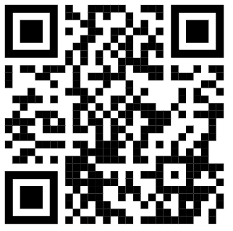
Survey and feedback
http://tinyurl.com/curc-survey18

